Slide 1

“Online Voting System Using Blockchain”
TERNA ENGINEERING COLLEGE
DEPARTMENT OF COPUTER ENGINEERING
BE/SEM-VII
Anjali Shinde. [C-22] Student ID - TU3F2122159
Harsh Minde. [C-28] Student ID - TU3F2122164
Under the guidance of
Prof. Sonali Nayan.
Academic Year
2024-25

Slide 2
CONTENT
Introduction
Abstract
Literature review
Problem Statement
Objective of Project
Scope of Project
Proposed System/ Architecture Diagram
H/W and S/W requirements
Expected Outcome
References

Slide 3
INTRODUCTION
This project focuses on using blockchain technology to improve the security and transparency of voting systems. Existing methods face issues like fraud and lack of trust, which blockchain's decentralized ledger can mitigate. The project builds on previous work to create a verifiable and secure voting system, advancing digital democracy.

Slide 4
ABSTRACT
This project develops a blockchain-based online voting system to enhance election security and transparency. By leveraging blockchain's immutable and decentralized features, the system prevents vote tampering and ensures real-time verification, addressing traditional voting challenges. The study aims to modernize and secure the electoral process through a reliable digital platform.

Slide 5
LITERATURE SURVEY
Sr. No. | Project Title | Author | Key Findings | Limitations
1. | Blockchain Enabled Online-Voting System | Akhil Shah, Nishita Sodhia, Shruti Saha, Soumi Banerjee, Madhuri Chavan​ 2020 | Utilizes blockchain to create an immutable and transparent voting system. Incorporates 128-bit AES encryption and SHA-256 for enhanced security. Authentication through unique identification keys and biometric fingerprint verification. Votes are cast and recorded as blockchain transactions, ensuring integrity and transparency. | The system currently uses Ethereum, a public blockchain, which may face scalability issues. The paper's model is designed for small organizations and may not be directly scalable to national-level elections. The use of fingerprint authentication alone may not be sufficient for comprehensive security, which we plan to enhance by integrating additional biometric measures such as facial recognition in our project.

Slide 6
Sr. No. | Project Title | Author | Key Findings | Limitations
2. | A Scalable Implementation of Anonymous Voting over Ethereum Blockchain | Jae-Geun Song, Sung-Jun Moon, Ju-Wook Jang 2021 | The system allows for scalability in terms of both the number of voters and candidates, surpassing the limitations of previous blockchain voting systems. Time complexity is reduced. | The scalability of the solution, while improved, still faces challenges when applied to "big voting" scenarios, such as national elections. The system relies on a large prime number to accommodate scalability, which could potentially lead to performance issues .

Slide 7
Sr. No. | Project Title | Author | Key Findings | Limitations
3. | Implementation of Decentralized Blockchain E-voting | Saad Moin Khan, Aansa Arshad, Gazala Mushtaq, Aqeel Khalique, Tarek Husein 2018 | Decentralized Security: Blockchain ensures a tamper-proof and transparent voting process. Smart Contracts: Automates and secures the voting process. Voter Trust: Real-time vote verification enhances transparency. User Interface: Metamask provides easy voter interaction with the system. | These are the limitations of this paper, and we are addressing them in our project: scalability issues, reliance on internet connectivity, complex setup, and the need for Ether. We are optimizing the system, adding offline options, simplifying the setup, and exploring alternatives to cryptocurrency.

Slide 8
Sr. No. | Project Title | Author | Key Findings | Limitations
4. | Decentralized Voting Platform Based on Ethereum Blockchain | David Khoury, Elie F. Kfoury, Ali Kassem, Hamza Harb 2020 | Smart contracts ensure transparency and enforce voting rules, allowing one vote per registered mobile number . Voter authentication is achieved without a third-party server, enhancing privacy and security . | The system may face challenges with scalability when deployed on a national level. Additionally, the requirement for users to have Ether for transactions may be a barrier.

Slide 9
PROBLEM STATEMENT & OBJECTIVE
PROBLEM STATEMENT :
Traditional voting methods are vulnerable to errors, tampering, even cost high, and lack transparency, leading to inefficiencies and security concerns. The growing demand for trustworthy elections highlights the need for a secure, modern solution.
OBJECTIVE:
The objective is to enhance security, increase transparency, and ensure voter privacy while improving accessibility and guaranteeing immutability. Additionally, the project aims to reduce costs, enhance trust, and facilitate real-time results.

Slide 10
SCOPE OF THE PROJECT
This system will replace traditional voting methods with a decentralized approach, significantly enhancing the integrity and trustworthiness of the electoral process. The scope of the project encompasses the development of a robust mobile application, seamlessly integrated with blockchain technology to ensure secure and transparent voting. Additionally, the project includes the integration of a secondary database to support data management and backup, ensuring reliability. Focus will also be placed on implementing advanced security measures and optimizing performance to safeguard the system against potential threats. Lastly, the project will address scalability to ensure the system can efficiently handle a large number of users and transactions, maintaining high performance during peak voting periods.

Slide 11
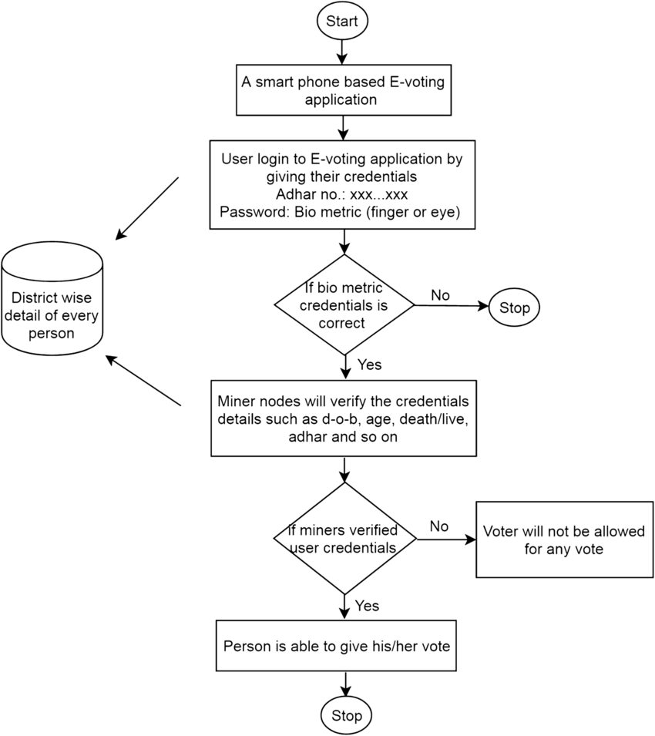
PROPOSED SYSTEM
Flow Chart :
User database

Slide 12
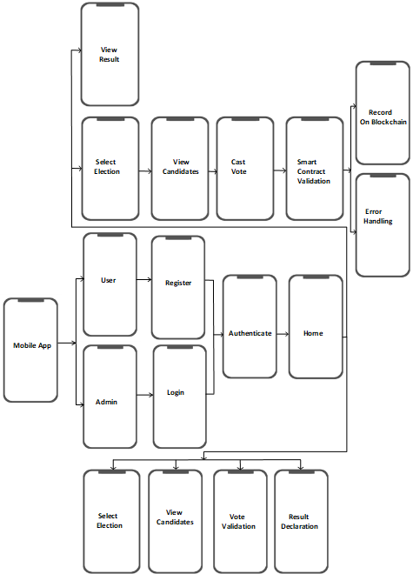
Architecture Diagram:

Slide 13
Sequence Diagram :-

Slide 14
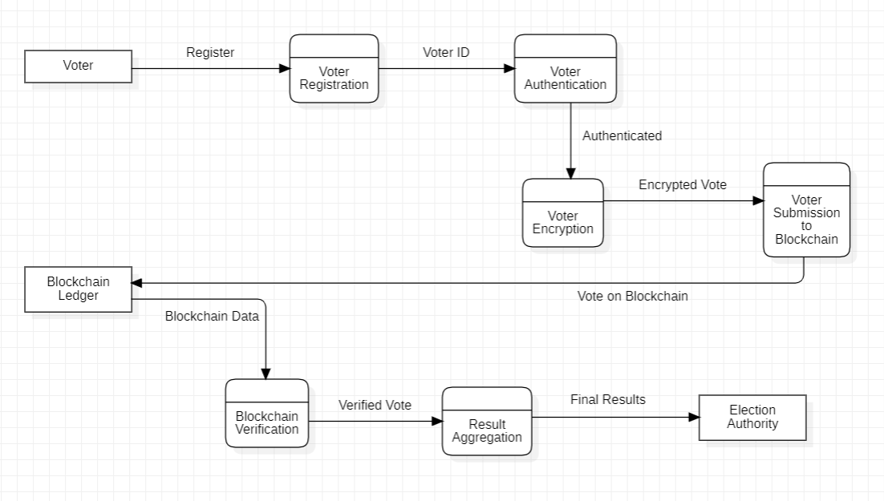
Data Flow Diagram (DFD) :-

Slide 15
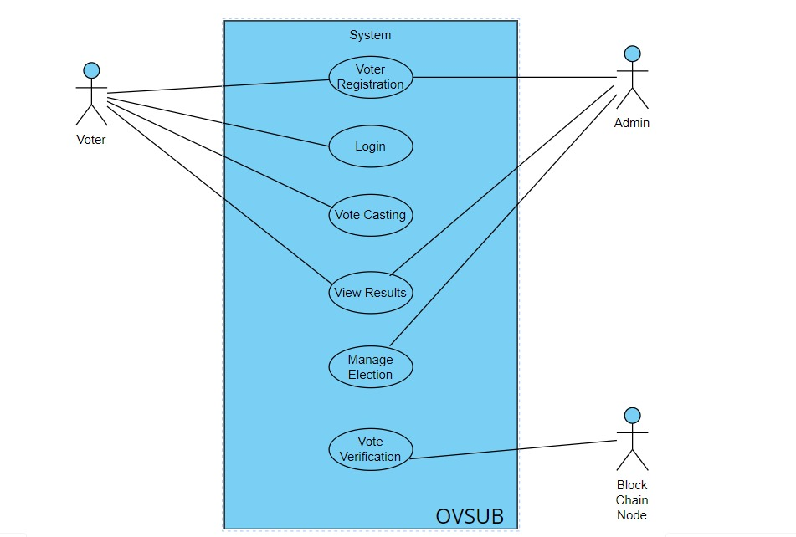
Use Case Diagram (UCD) :-

Slide 16
PROPOSED SYSTEM
Users register and log in using multi factor authentication, secured by biometric authentication.
After successful login, they cast votes via a secure interface, with each vote recorded on the Ethereum blockchain using Solidity smart contracts to ensure uniqueness and prevent duplication.
Non-sensitive data / metadata is stored in Secondary database, while sensitive vote data is securely stored on the blockchain for transparency.
Real-time election results are fetched from the blockchain and displayed on a user-friendly interface developed in Android /Flutter.
The system ensures end-to-end encryption, voter anonymity, and is designed to handle large user loads during peak voting times.

Slide 17
HARDWARE USED
Mobile Devices:
Smartphones (iOS and Android)
Tablets (iOS and Android)
Servers:
Blockchain nodes servers
Backend servers
Cryptographic Hardware:
Hardware Security Modules (HSM)
Development and Testing Hardware:
Laptops/Desktops for developers
Test devices (various models of smartphones and tablets)
5. Security Hardware:
Biometric authentication devices (optional, for enhanced security)

Slide 18
SOFTWARE USED
1.Blockchain Network:
- Ethereum
2. Smart Contract (Development):
- Solidity
3. Mobile App Development Frameworks:
- Android
- Flutter
4. Database:
- Firebase
- MongoDB
5. Development and Testing Tools:
- Truffle
- Ganache
- Android Studio
- Remix IDE
6. API Integration:
- Web3.js
- Ethers.js

Slide 19
EXPECTED OUTCOMES
We expect that the system will allow voters to securely cast their votes via a mobile application, with immutable vote records on the blockchain to prevent tampering, ensuring a transparent election process through a public ledger accessible to all, while protecting voter identity. Additionally, real-time results will be directly calculated from the system, with scalability to handle large-scale elections, and auditability will provide election officials with access to logs to maintain election integrity.

Slide 20
REFERENCE
Research Papers and Articles:
Akhil Shah, Nishita Sodhia, Shruti Saha, Soumi Banerjee, Madhuri Chavan (2020). "Blockchain Enabled Online-Voting System," ITM Web of Conferences, 32, 03018.
Jae-Geun Song, Sung-Jun Moon, Ju-Wook Jang (2021). "A Scalable Implementation of Anonymous Voting over Ethereum Blockchain," IEEE Access, 9, 37930-37942.
Saad Moin Khan, Aansa Arshad, Gazala Mushtaq, Aqeel Khalique, Tarek Husein (2018). "Implementation of Decentralized Blockchain E-voting," International Journal of Computer Applications, 182(20), 1-5.
David Khoury, Elie F. Kfoury, Ali Kassem, Hamza Harb (2020). "Decentralized Voting Platform Based on Ethereum Blockchain," 2020 International Conference on Decentralized Applications and Infrastructures (DAPPS), 65-70.

Slide 21
THANK YOU !!

